Slide 1


Attendance QR (Week 5, Session 2)

Slide 2
Meeting 5
STM32 Embedded Programming
IEEE - CSULB Branch

Slide 3
Agenda
Language Hierarchy
HAL Library
Code File Types
Memory Types
Transistor Uses
Transistor Parameters (Datasheet)
Transistor Visualization
Picking a Transistor
Demo: MOSFET and Motor Driving

Slide 4
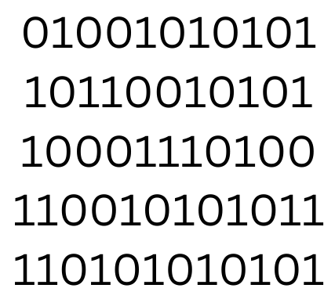
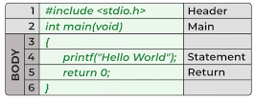
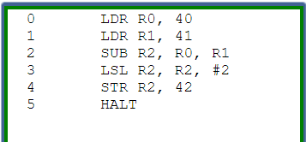
Language Hierarchy
Compiler
Assembler
High-Level Language (HLL)
Source code uses words in English language
Languages we know: Python, C++, C
Assembly Language
Source code contains mnemonics
Final Machine Code
Soley binary
Linker
Library Files

Slide 5

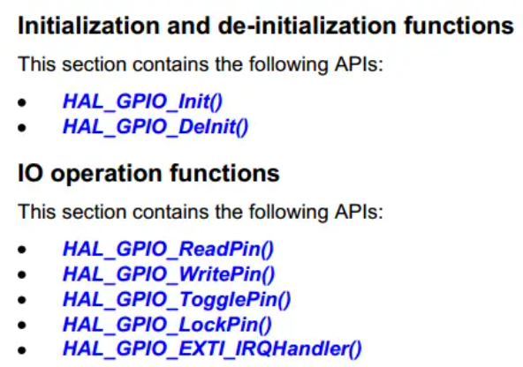
HAL Library
A library is a file with predefined functions that the user can call for ease of use and reusability.
The Hardware Abstraction Layer (HAL) library is provided by STMicroelectronics:
High and low-level control of hardware
Standardized API
One HAL library per series
F4 series -> stm32f4xx_hal
Function Example: HAL_GPIO_TogglePin()

Slide 6
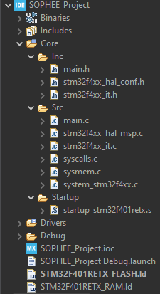
Code File Types
C/C++ uses two main files: Header and Source Files
Header (.h) files contain function prototypes as well as declarations of constant variables and libraries.
Header files are “list of recipes”
Source (.c) files contain the actual functions and use variables defined in the header file.
Source files are “steps to complete recipes”
Assembly (.s) files are sometimes used for more low level control.

Slide 7
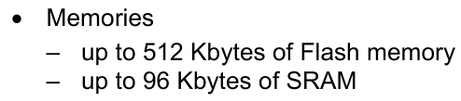
Memory Types
STM32 main memories: Flash Memory and SRAM
Flash Memory is a type of nonvolatile memory that can electrically erase and rewrite stored data.
Nonvolatile memory is the memory that can keep data even when it is powered off.
Used to store compiled code and other data that must be preserved when powered off.
Static Random Access Memory (SRAM) is a type of volatile memory used for temporary storage.
Faster and smaller than flash memory.

Slide 8
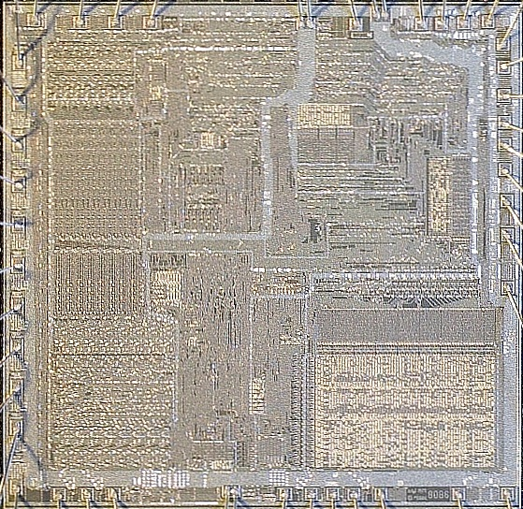
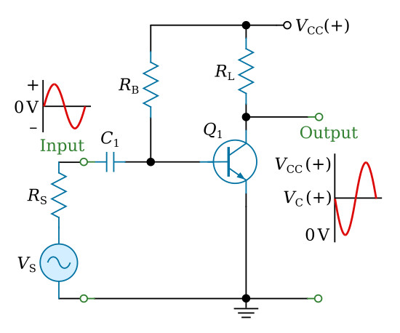
Transistors
Active semiconductors that can block or allow electric current to flow from one path to another.
In a core processor, can act as logic gates to transmit data through high (1) and low (0) states.
Can be used as an amplifier to increase the magnitude of electrical signals.
Millions to billions of transistors in computers

Slide 9
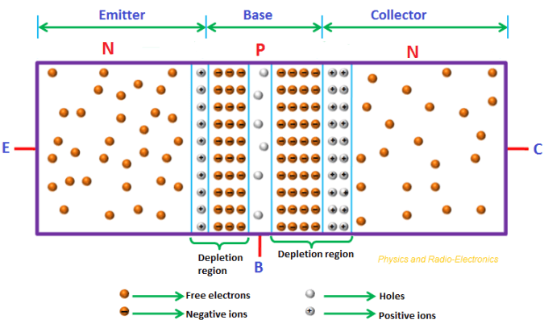
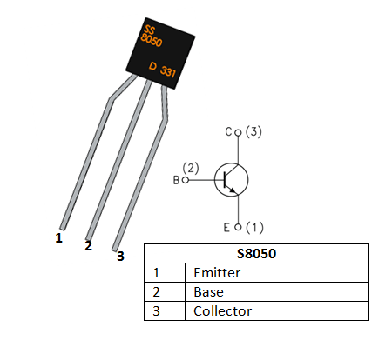
Transistors (cntd.)
Bipolar Junction Transistor (BJT)
Once a small current is applied at the base, electrons and holes can flow.
Current will flow from the collector to the emitter for NPN type.
Notes:
for more imfo
EE 220
EE 420

Slide 10
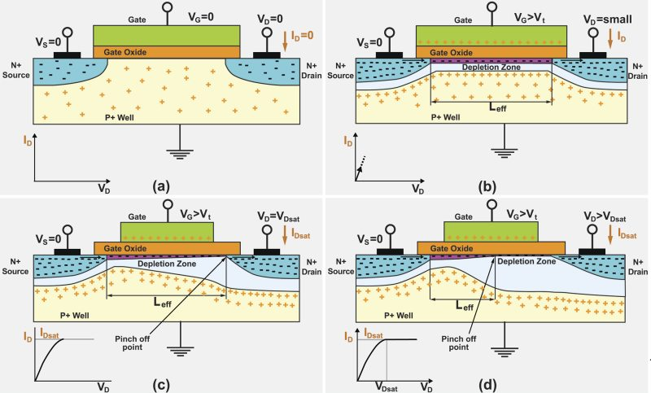
Transistors (cntd.)
Metal Oxide Semiconductor Field Effect Transistor (MOSFET)
Once a voltage is applied at the gate electric fields will create a channel or allow a channel to conduct causing current to flow between the source and drain.

Slide 11
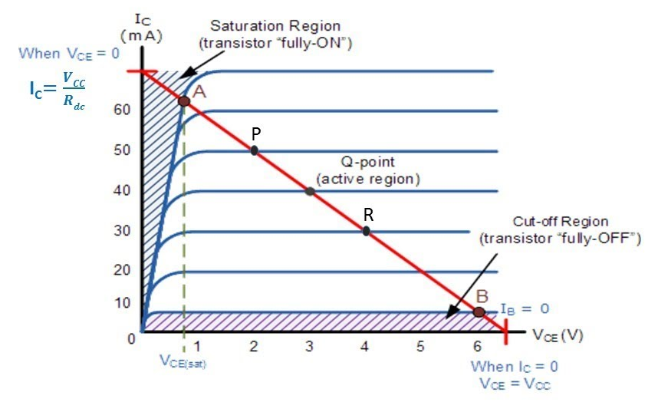
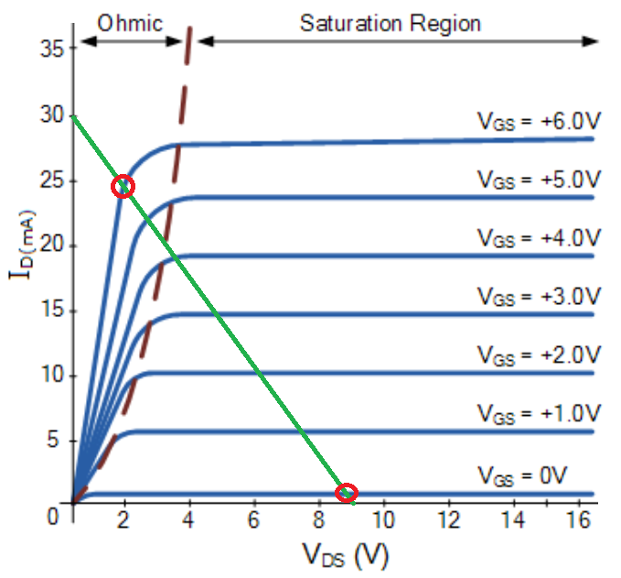
Transistor Parameters (Datasheet)
Load Line of an NPN BJT
Cutoff Region
Saturation Region
Active Region
Load Line of a MOSFET
Ohmic Region
Saturation Region

Slide 12
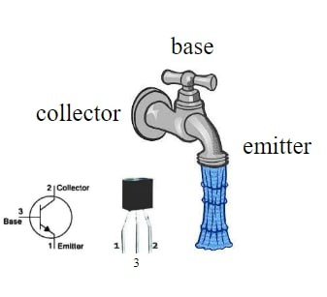
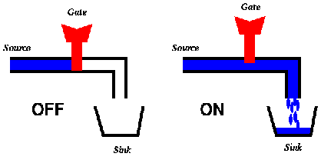
Transistor Visualization
BJTs: Like a valve because of its linear active region. Increase/decrease in input signal affects output signal proportionally.
Similar to a sink faucet
Cutoff: No flow
Saturation: Absolute flow
Switching mechanism is controlled in-circuit
Roles can change
MOSFETS: Like a plug since it can switch rapidly between high and low. Efficiently conducts square waves.

Slide 13
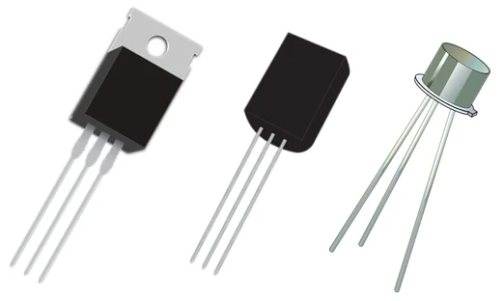
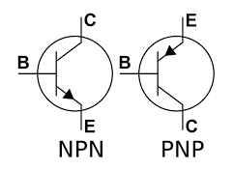
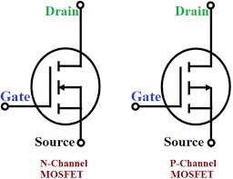
Picking a Transistor
Bipolar Junction Transistor
Current-controlled
Cheaper
Low frequency amplification
Preferred for analog signals
MOSFET
Voltage-controlled
Rapid switching speeds
Higher frequency amplification
Preferred for digital signals

Slide 14
Demo: MOSFET and Motor Driving
What is needed?
Software:
STM32CubeIDE
Hardware:
NUCLEO-F401
Breadboard
Diode (anti-flyback)
DC Motor
N Channel MOSFET
1 1KΩ Resistor
1 10KΩ Resistor
2 Μultimeters
DC Supply

Slide 15
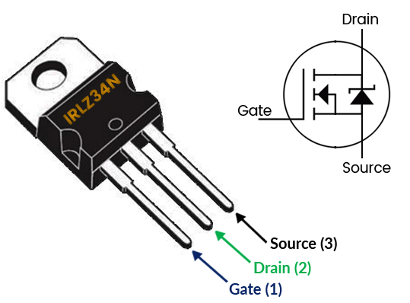
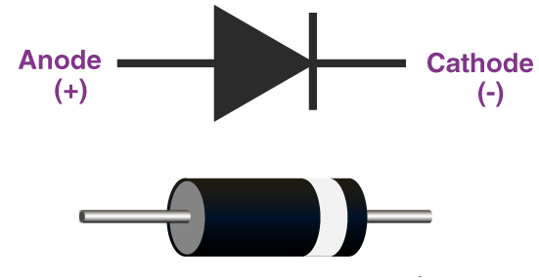
Demo: MOSFET and Motor Driving

Slide 16
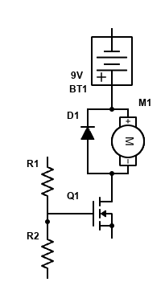
Demo: MOSFET and Motor Driving
Connect the PWM signal pin to a 1kΩ resistor.
Connect the other terminal to a separate that column.
From that column, make 2 connections: to a 10kΩ resistor that goes to ground and the gate terminal of the MOSFET.
Connect the 9V battery pin to a column on the breadboard.
Make 2 connections from that same column: the anode of the motor and the cathode (grey bar) of a diode.
The other pins of the motor and diode are connected to the same column of the drain pin of the MOSFET. Ground the source pin of the MOSFET.
+5V Pin
or
9V Battery
PWM Pin
1KΩ
D
G
S
10KΩ

Slide 17
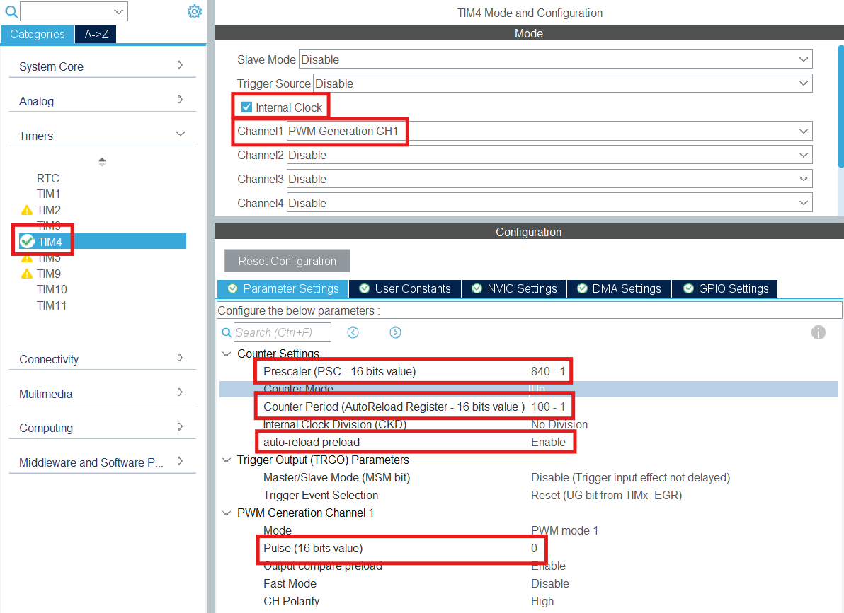
Demo
Create new STM32 project
Edit highlighted settings to setup PWM with frequency of 84Mhz / 840 / 100 = 1kHz.
Set initial Pulse to 0 so the motor doesn’t activate immediately when running code.

Slide 18
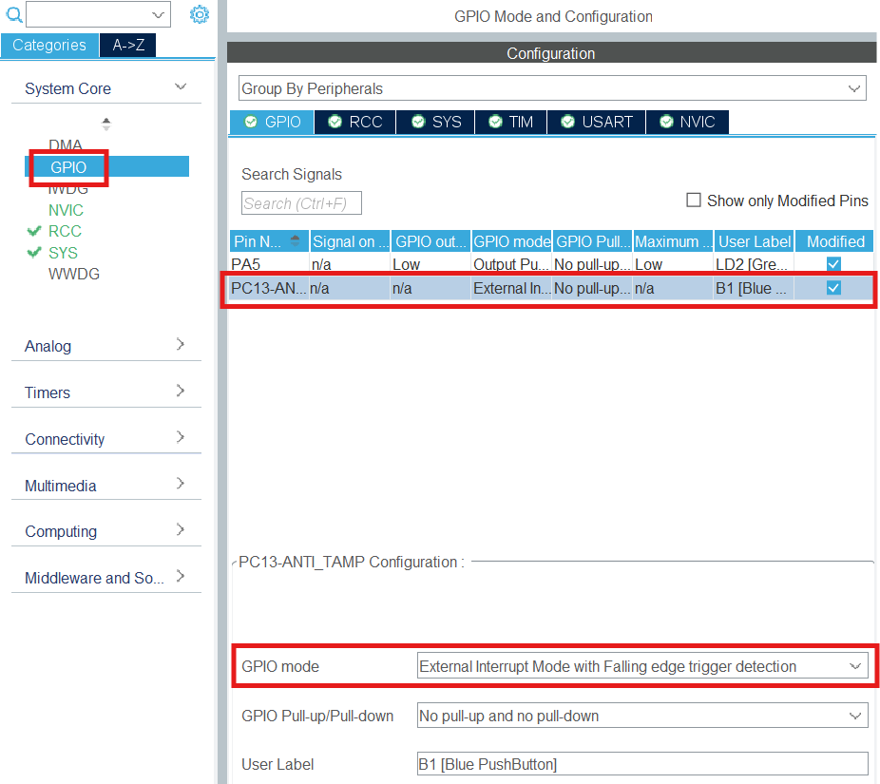
Demo
GPIO mode should be set to falling edge trigger since pressing the button makes PC13 read a high state while letting go makes PC13 read a low state.
We want toggle the motor speed after releasing the button.

Slide 19
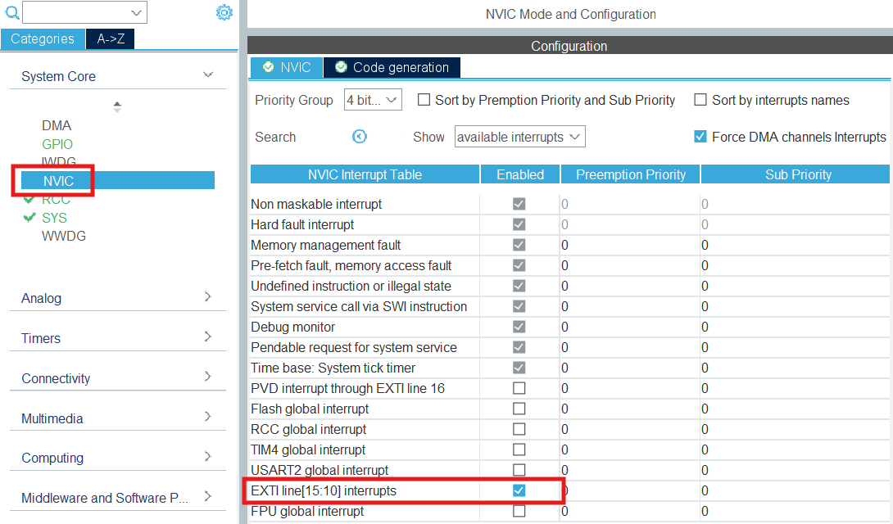
Demo
Enable external interrupts so PC13 which is connected to the blue push button can be used as an interrupt.

Slide 20
Demo: MOSFET and Motor Driving
In main.c file starting around line 32:
/* USER CODE BEGIN PD */
int mode = 0;
/* USER CODE END PD */
In main.c file starting around line 96:
/* USER CODE BEGIN 2 */
HAL_TIM_PWM_Start(&htim4, TIM_CHANNEL_1);
/* USER CODE END 2 */
Create global variable to keep track of what speed the motor is running at.
Start the PWM signal on pin D10.

Slide 21
Demo: MOSFET and Motor Driving
In main.c file starting around line 290:
/* USER CODE BEGIN 4 */
void HAL_GPIO_EXTI_Callback(uint16_t GPIO_Pin)
{
/* Prevent unused argument(s) compilation warning */
UNUSED(GPIO_Pin);
if (mode < 4)
{
mode = mode + 1;
TIM4->CCR1 = 35 + mode * 10;
}
else
{
mode = 0;
TIM4->CCR1 = 0;
}
}
/* USER CODE END 4 */
Whenever any external interrupt is triggered, this function will run, such as the falling edge of pin PC13.
The if statement will increase the pulse (and therefore duty cycle) for higher mode variable values.
For this code, register CCR1 can take on the values 0, 45, 55, 65 which are all less then the counter period of 100.

Slide 22
Demo: MOSFET and Motor Driving
Run the code.
Press the blue button to toggle the motor speed.
(Optional) With oscilloscope, probe the positive end between PWM and R1 then the negative end between R2 and GND.
(Optional) With oscilloscope, probe the positive end between the battery and the DC Motor then the negative end between the DC Motor and drain pin (D).
MOSFET allows or blocks current flow through the drain to source based on the voltage at the base which is changing due to the PWM signal rapidly switching between LOW/HIGH.
The output speed is therefore dependent on the duty cycle.
+5V Pin
or
9V Battery
PWM Pin
1KΩ
D
G
S
10KΩ

Slide 23
Join us next meeting for Part Types/Sourcing!
Please have Altium Designer for next week. Any Questions?

